Slide 1
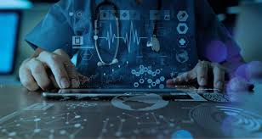
Disease Prediction and Analysis

Slide 2
Team Members :
Shreyansh Tyagi (2000290140116)
Sneha Singhal (2000290140122)
Shweta Rani(2000290140120)
Supervisor
Mr. Ankit Verma
Assistant Professor

Slide 3
Introduction
Nowadays, more people are affected by various diseases such as blood pressure, heart failure, etc.
The early prediction of diseases tends to increase the survival of affected patients by allowing preventive action.
A key element for this purpose is the digitalization of the healthcare system through the Internet of Things (IoT) and cloud computing.
Automated Disease Detection System (ADDS): A Sensor-Input-based Reliable Model for Disease Detection.
The objective of this work is to propose an intelligent technique which can be used for determination of diseases in human body.
The problem of health monitoring has been taken as it is one of the challenging problems for elderly people, and in rural areas where most of the times people do not get proper treatment and are not financially sound to visit doctors in city.
Many lives are lost due to lack of proper treatment which in turn can be saved if proper prognosis is done on time.

Slide 4
Proposed Methodology
The information will be gathered from regular visit of doctors and reviewing existing literature work related to it, online medical support provided by different websites.
In our research here we introduce machine learning neuro fuzzy based algorithms Generalize approximate Reasoning base Intelligence Control with regression rules to predict the disease early.
To calculate the severity we use various Machine Learning algorithm like Random Forest, Linear Regression, Naive Bayes, etc.
we have to inject the sensor in human body, sensor function is linked with IoT (Internet of Things) like mobile app or any other, also it connected to service provider or hospitals.
Thus if the people has affected by some diseases they will get warning by SMS, emails..etc, after that they got some treatments and advisory of doctors.

Slide 5
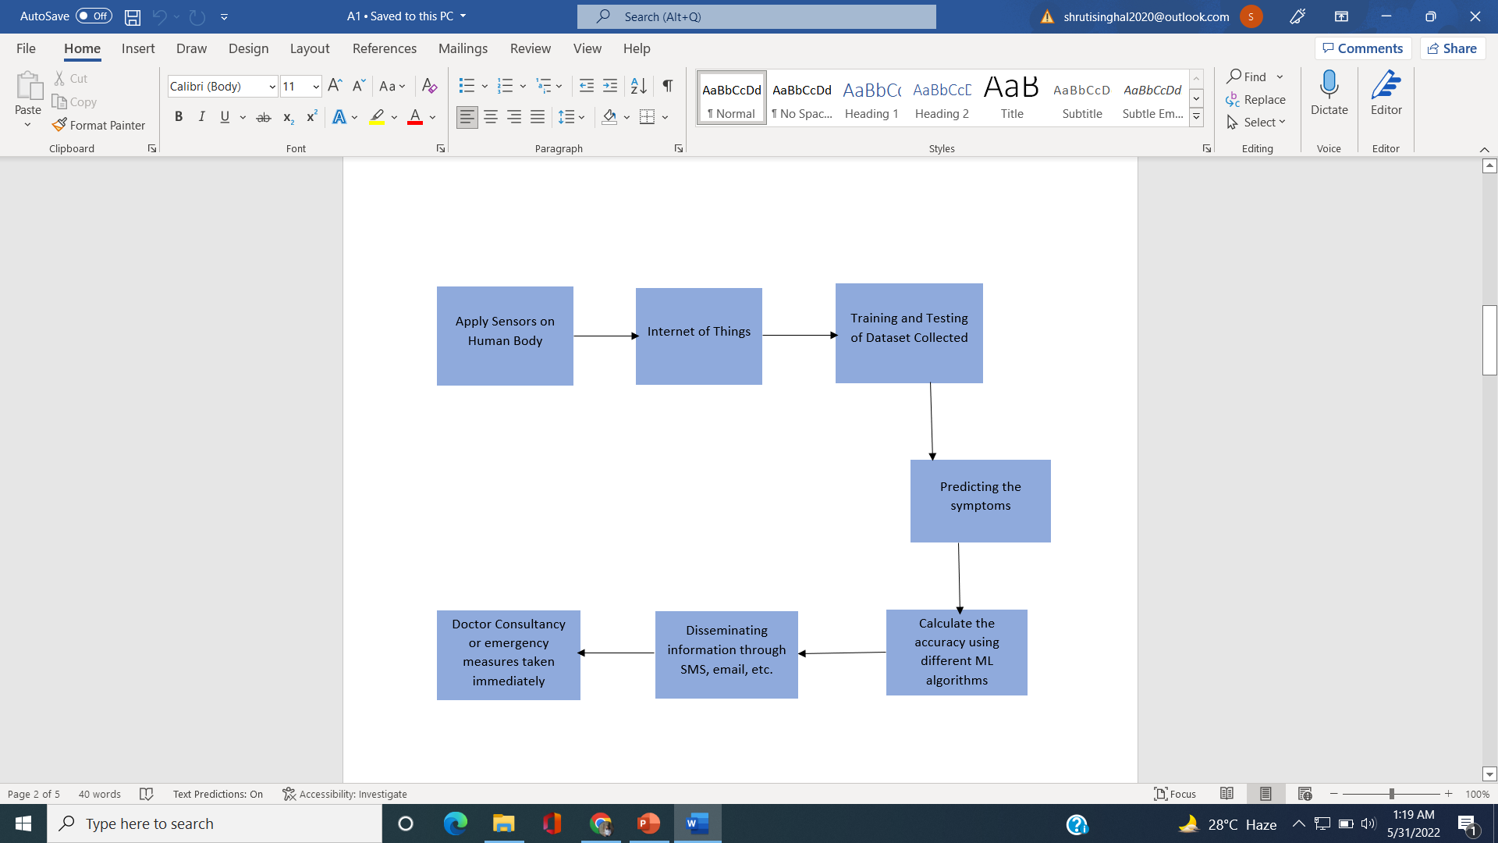

Slide 7
Aim of the Work
To obtain the real-time medical information about a patient via IoT.
Processing and classification of information gathered about the patient.
To interpret and predict any disease or disorder in preliminary stage itself using the data mining techniques that will also provide the approach advantageous for decision making.
To provide Internet of Things based healthcare solutions at anytime and anywhere.

Slide 8
Steps of work
Identification of disease on which data collection and model will be presented.
Identification of sensors for collection of data.
Designing a system by using which sensors data will collected in a database for particular human body.
Discussion with doctor for some diseases for getting some "if-then rule based data".
Training of system with doctor's data and sensor's data.
Predication of the chances of disease.

Slide 9
Expected Outcome
Our research work is elaborated using PYTHON, to calculate the efficiency of proposed techniques with existing techniques in the terms of
Accuracy
Predicting rate
Severity
Sensitivity

Slide 10
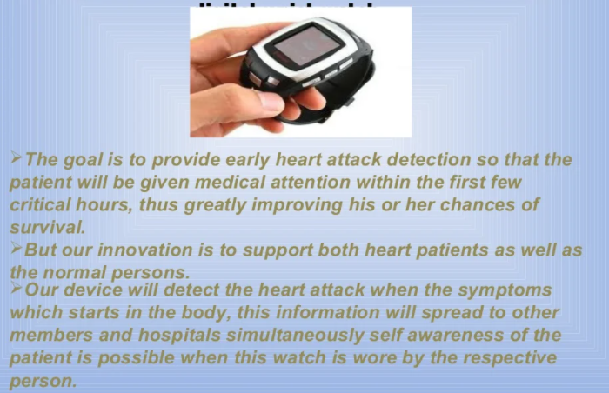
FUTURE SCOPE!

Slide 11
Thank you!

